Slide 1
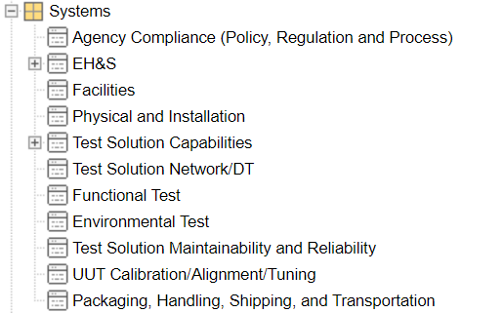
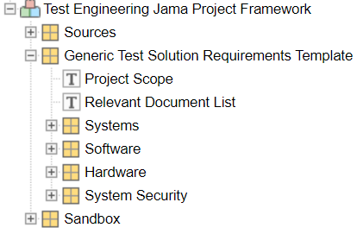
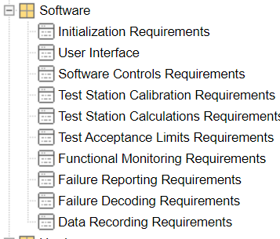
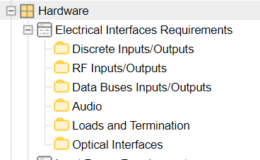

Systems Engineering – Jama Projects Template
Notes:
Group discussion – who writes the HW, SW, EE type requirements? Systems??? Domains? Domains don't currently have training in writing requirements.

Slide 2
Expected Level of Details for System Requirements
Expected Requirements Content
Agency Compliance (Policy, Regulation and Process) Requirements:
These are requirements essential to ensure the safety, quality, and reliability.
These requirements are established and enforced by Corporate policy and various regulatory agencies affecting system operation or performance, as an example:
International Traffic in Arms Regulations (ITAR)
Federal Communications Commission (FCC)
Occupational Safety and Health Administration (OSHA)
MIL-Spec
Etc.

Slide 3
Expected Level of Details for System Requirements
Expected Requirements Content
Environmental, Health and Safety Requirements:
Requirements directed to human factors relate to human users and their interaction with the system such as efficiency, health effects, and communication. Related terms are Human Engineering and Human System Integration. Industry standards to consider include MIL-STD-882, MIL-STD-1472, MIL-STD-46855, and SAE SAE6906.[GC1] [EKC2]
A dedicated Safety Engineer or a designated SE is responsible to determine, in coordination with other disciplines and agencies, the safety requirements for a test solution.
Requirements defined to prevent failure conditions or to provide safety related functions are uniquely identified and traceable.

Slide 4
Expected Level of Details for System Requirements
Expected Requirements Content
Environmental, Health and Safety Requirements:
SBUs have different safety guidance documents tailored for their needs.
ATE-SE uses IEC 61010-1 for general safety guidance. SBUs might have a need for other parts of IEC 61010.
ATE-SE also uses the heritage Rockwell Collins (hRC) guidance as follows.
HRC-OPS-I-752 Test Equipment Safety Checklist with reference to HRC 074-8434-282.
HRC 074-8434-535 System Safety Engineering Design Checklist
HRC-OPS-C-002 Test Equipment – Peer Review Checklist.

Slide 5
Expected Level of Details for System Requirements
Expected Requirements Content
Facilities Requirements:
These requirements cover any requirements that needs to be imposed on facilities where the Test Solution will be installed
It may include:
Structure support requirements
Electrical infrastructure requirements
Etc.

Slide 6
Expected Level of Details for System Requirements
Expected Requirements Content
Physical and Installation Requirements:
These are a system’s physical characteristics relative to its installation environment. Consider weight, dimensions, power, cooling, markings, etc.

Slide 7
Expected Level of Details for System Requirements
Expected Requirements Content
Test Station Capabilities
UUT part numbers to be covered by the Test Solution
Architecture to be used to meet testing needs
Adaptable: Provide provisions for growth, expansion, capability, and contraction to future system or system element capability.
Functional and Environmental Capabilities including limits
Temperature Chamber and associated limits
Test Station Shall include a thermal chamber that meet the specification below:
Internal normal temperature operating range from -55 C to +55 C, AND
External normal temperature operating range from -20 C to +40 C, AND
Minimum rate of temperature change of 10 C/min, AND
Maximum power consumption XXXX watt, AND
Maximum normal operating current drawn XX Amp, AND
Maximum in rush current XX AMPs.

Slide 8
Expected Level of Details for System Requirements
Expected Requirements Content
Functional and Environmental Capabilities including limits
Example: Vibration Table and associated limits
Test Station shall include a Vibration Table that meet the specification below: → Or you list the spec in table
Sine/Random/Shock Forces of levels XXX F-lb pk/rms, AND
Max displacement xx.xx pk-pk , AND
Vibration/Rotation Axis (1/2/3 axis) , AND
Vibration Frequency range Hz to XXXX Hz, AND
Maximum power consumption XXXX watt, AND
Maximum normal operating current and voltage XX Amp at 480 V, AND
Maximum in rush current XX AMPs.
Smaller project may use the structure in the example.
Larger projects may elect to separate the hardware content in the HW requirements section.

Slide 9
Expected Level of Details for System Requirements
Expected Requirements Content
Discrete Type Electrical Interfaces
List all signal pins that needs to be connected or controlled during testing
Signal name (in a table?)
Pin number including connector designator
List the acceptable state for each discrete:
Low: Ground,-5,-3, etc..
Open Circuit
High: +5V, +3V, etc..
List the electrical specification for each state
Low: 0 V to 0.45 V, less than 5 milliohm, etc..
Open Circuit
High: 4.5 V to 5 V, etc..

Slide 10
Expected Level of Details for System Requirements
Expected Requirements Content
Discrete Type Electrical Interfaces
List the mapping between the physical discrete signal and the databus content

Slide 11
Expected Level of Details for System Requirements
Expected Requirements Content
Test Solution Network/DT Requirements
Provide details of any unique equipment or functionalities needed to support testing
Equipment/Computer configuration (CPU, RAM, Hard drive, etc. )
Operating System (Windows, Linux, etc.)
Software Licenses (LabVIEW, C#, CIMCO, etc.)
VPN needs/configuration
Cloud Computing capabilities
User accessibility to equipment (Computer/Databases passwords, Access Cards, etc.)
Connectivity to Collins or local facility network
Test Station actions in the event of network failure
Test Station continue operation, record & stores test data/result and report it once network connectivity restored.

Slide 12
Expected Level of Details for System Requirements
Expected Requirements Content
Functional Test: Everything pertains the actual UUT testing needs
It should describe system or system element functions or tasks to desired system performance under stated conditions.
They include customer desires, operational constraints, regulatory restrictions, and implementation realities, examples:
Operational requirements describe how the operator interfaces with the test solution system, and support teams, and related functions or equipment (Consider normal and abnormal conditions).
Performance, a characteristic of function, requirements describe function or system attributes useful to the test solution operation such as expected performance, accuracy, fidelity, range, resolution, speed, and response times (Performance is normally expressed quantitatively).
System Modes and States Requirements defines the various operational modes or states.
Interface requirements are the system’s physical inputs and outputs, and a description of how they operate/behave with other systems and human elements.

Slide 13
Expected Level of Details for System Requirements
Expected Requirements Content
Environmental Test: It defines the environmental conditions the UUT may be subjected to such as noise, shock, and electromagnetic tests.
Example:
The Test Station shall screen for intermittent failures (to detect hardware faults) for the duration of the Rapid test sequence of 85 seconds per unit while being subject to:
Thermal transitions as defined in REQ-ABC, and
Vibration as defined in REQ-ABC, and
Simulated altitude of 5000 feet.

Slide 14
Expected Level of Details for System Requirements
Expected Requirements Content
Test Solution Maintainability and Reliability
It defines provisions in the test solution to allow for scheduled and unscheduled maintenance, failure detection, fault isolation, etc.
System reliability requirements are quantitative and pertains to system reliability.

Slide 15
Expected Level of Details for System Requirements
Expected Requirements Content
UUT Calibration/Alignment/Tuning
These requirements are functional requirements type that are separated from the Functional folder to adhere with the ATP template.
It defines the calibration and alignment needs for the UUT, in the event deemed to be necessary by Design Engineering.
Example: RF Power Calibration requirements for UUT with RF TX/RX functionality.

Slide 16
Expected Level of Details for System Requirements
Expected Requirements Content
Packaging, Handling, Shipping, and Transportation Requirements:
Includes packaging, handling, shipping, transportation, and storage of the system and system elements.
Examples:
The Test Station Rack shall be designed with the ability to easily move it around the facility without special equipment or tools. → Rollers for the rack base.
The Test Station Rack shall have all necessary marking (ESD, Weight, High Voltage, Battery, etc..) to provide sufficient instruction for safe transportation.

Slide 17
Expected Level of Details for System Requirements
Expected Requirements Content
System Security Requirements:
System security relates to the facility where the system is installed and the system’s operational security such as log-in access and data protection.
Examples:
The Test Station shall be located in a secured, badge access controlled, facility with access controlled by an administrator.
The Test Station Operating System shall sign out the user within 10 mins of no user activity.
The Test Station Operating System shall be password protected.
The Test Station Software shall be password protected.

Slide 18
Expected Level of Details for System Requirements
Expected Requirements Content
Cybersecurity Requirements:
Cybersecurity is a subset of System Security.
Refer to GCP-55, FCP-TGE-001, COL-PCO-PRO-0002, and AVI-PCO-PRO-0002 for more detailed guidance.

